Slide 1
Grammar, Punctuation, & Spelling
Some Common Pitfalls

Slide 2
Why is grammar important?
Adds/detracts ethos
Can change intended meaning

Slide 3
The it’s, its debacle
It’s always means it is
Its is possessive
Its’ is not a word; don’t use it

Slide 4
Barnes & Noble at NMSU

Slide 5
You’re/Your
You’re always means you are. You’re welcome.
Your is possessive.

Slide 6
They’re over there with their dogs.
They’re always means they are
Their is possessive (their books, their pens)
There indicates direction (over there) or a relation (There are several…)

Slide 7
Effect or Affect?
Affect is a verb
She was affected by the sad movie.
Effect is a noun
The effects of his speech are still being realized today.
*Small caveat: sometimes—but very rarely—effect is a verb
The legislation can effect change. (Bring about)

Slide 8
Pronoun agreement
A student is responsible for _______ grade.
Students are responsible for ______ grades.
If one can excel in college, _____ can usually succeed in the workplace.
Be aware of discriminating people based on gender
If his or her / he or she feels clunky, make sure to alternate what pronoun you use

Slide 9
Parallelism
In a series, all items should be parallel in form
The horse walked, trotted, and was running on the track.
The children ran down the hill, skipped over the lawn, and into the swimming pool.

Slide 10
The apostrophe
Which is right?
My parents’ house
Or my parent’s house

Slide 11
Starting Sentences
Can you start a sentence with
However?
And?
Because?

Slide 12
Semicolons
Are used to separate two ideas that can stand alone
The literature professor commonly teaches film theory; she is interested in how movies represent women.
Also used in complicated lists
Kress, 1999; Gee, 1989; and Yancey, 2004.

Slide 13
Some (possible) humor
Let’s eat grandma! Or: Let’s eat, grandma!
Woman: without her, man would be nothing. Woman: without her man, would be nothing.

Slide 14
A tip from Mark Twain
“Substitute ‘damn’ every time you're inclined to write ‘very’; your editor will delete it and the writing will be just as it should be.”

Slide 15
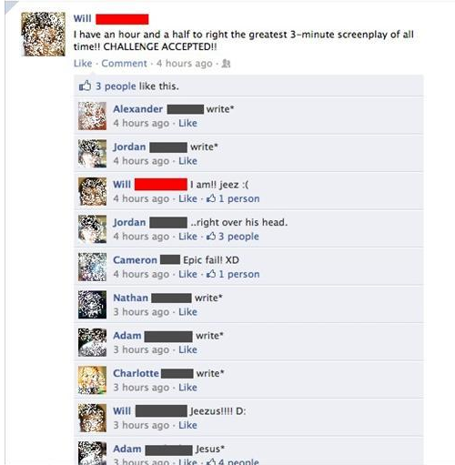

Slide 16
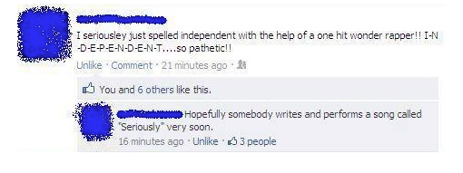

Slide 17
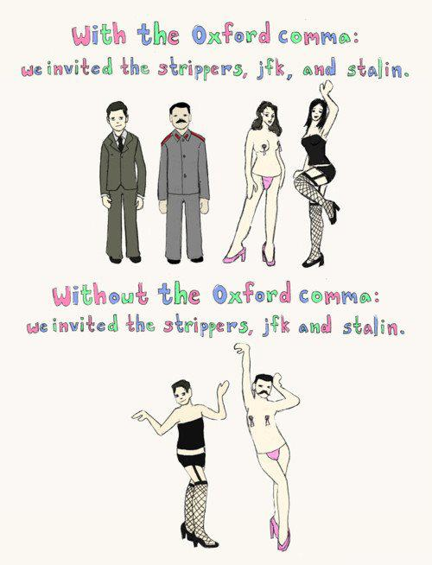

Slide 18
From the NY times:
”…highlights of his global tour include encounters with Nelson Mandela, an 800-year-old demigod and a dildo collector.”

Slide 19
Some tips
Step away from your paper for awhile before you start to edit for grammar, spelling, and punctuation.
Carefully examine the common pitfalls

